Slide 1
Dashboard Creation for IPL Matches
analysing the game using past trends

Slide 2
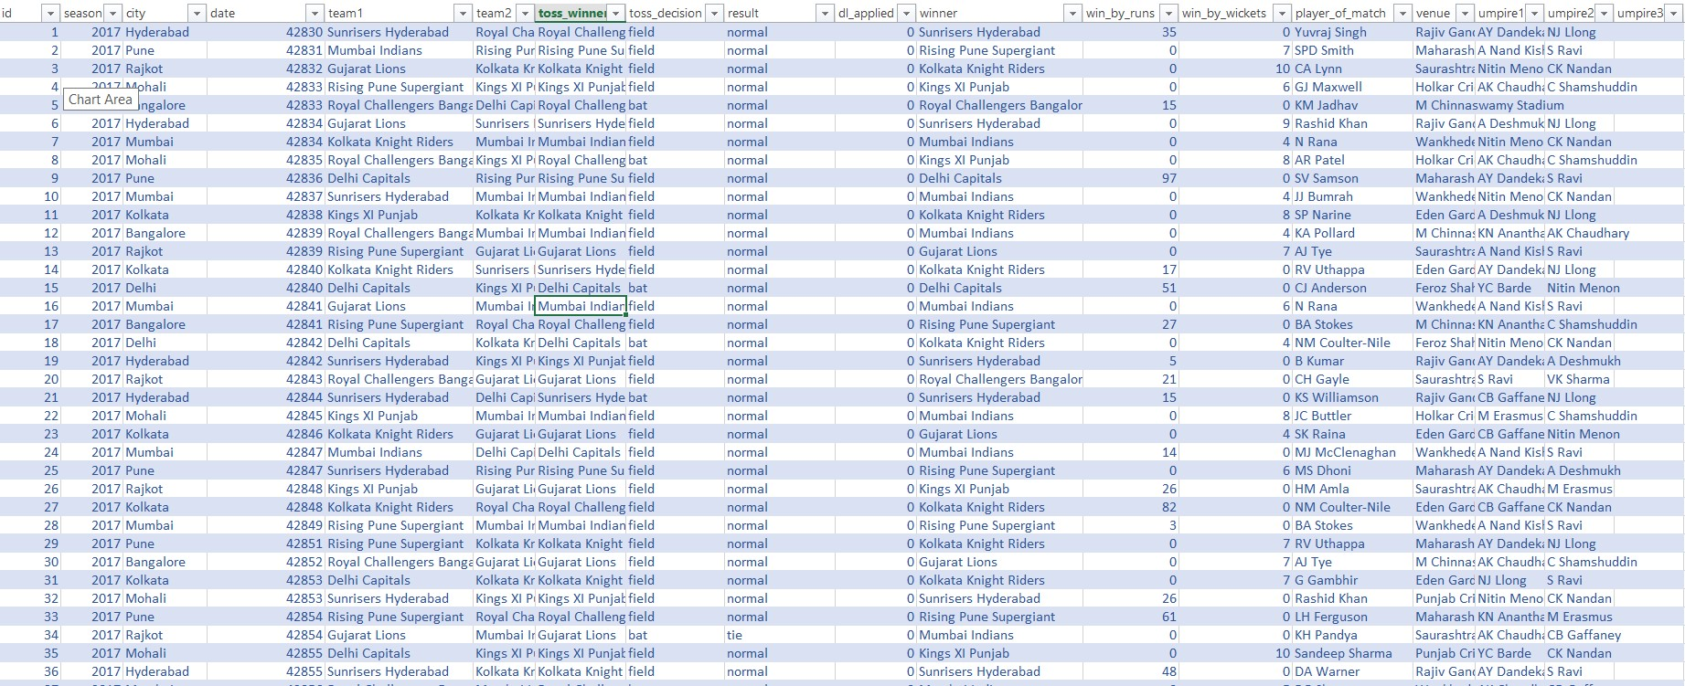
The Core of the project : The Data
Choosing the right dataset is the first very crucial step.
The dataset chosen for this project is a huge collection of IPL matches played during season 2008-2019.
It contains all the necessary information of all the matches:
Teams Name, Toss Winner, Toss Decision, Winner, Win by Runs, Win by Wickets, Player of Match, Venue and many more. This vast dataset helps to get lot of insight from the data which can then be used to analyse outcomes of the future matches.

Slide 3
The Actual Stuff: Creating The Dashboard
Dashboard creation occurs in several stages:
The First one is data cleansing or analysing the data for missing items, incorrect items and correcting it for the proper building of the dashboard.
The second step is to build questions that can be asked to a dataset because that will help to choose dependent and independent variable for making the Pivot Charts.
The Third step is adding various slicers and add formatting to our dashboard to make it look good.

Slide 4
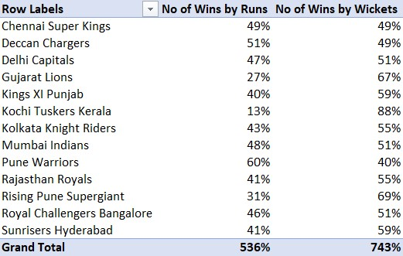
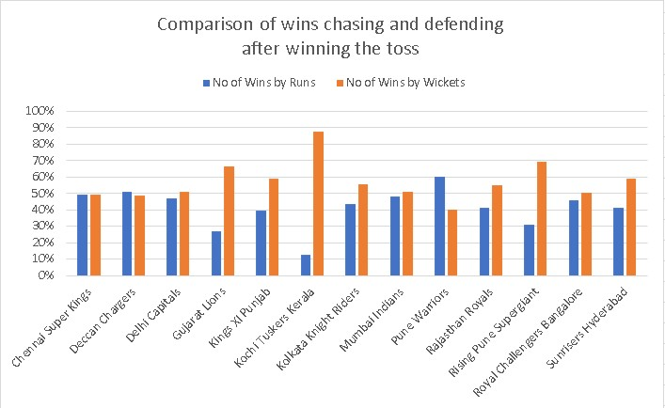
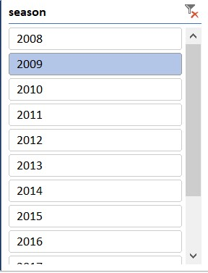
Choosing Rows and Column Variables
The Three Steps To Making Dashboard
Making Pivot Charts
Adding Slicers

Slide 5
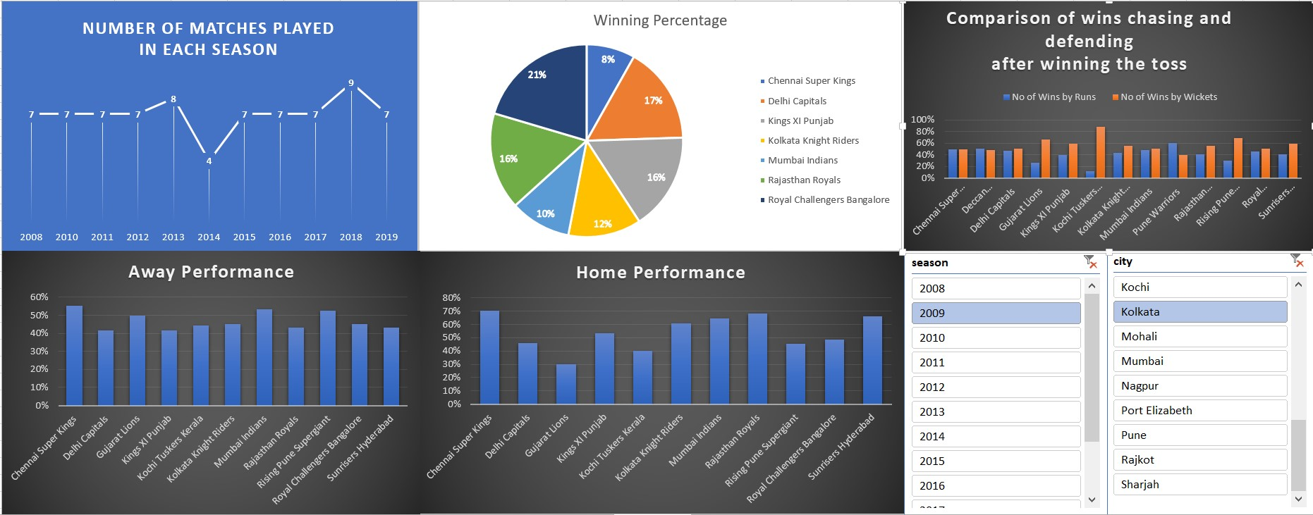
Final Dashboard

Slide 6
The Goal: Insights From Analysing The Dashboard
Analysing One Of the Pivot Charts which is A Comparison of wins when choose chasing and defending after winning the toss. It can be clearly seen for some teams the winning ratio in the two scenario is quite large such as Kochi Tuskers Kerala and Rising Pune Supergiant while for others it is almost equal such as Chennai super Kings. So it is very important for their team to know their performance when they choose to defend and when they choose to chase. This knowledge only comes from collecting the results of all the matches and so it shows the undeniable need of tools like dashboard that can cause a difference of winning and loosing the match.

Slide 7
Conclusion
This Project of Creating the dashboard for IPL matches shows the importance of dashboard and how it can help in analysing the IPL matches which can be utilised in making better decisions. This is a very great tool that makes study of the raw form the match data very easy.

